Slide 1

Course Title:
MCSE 662 – Evolutionary Algorithm
Systematic Literature Review on Particle Swarm Optimization Techniques for Medical Diseases Detection

Slide 2
Submitted To: Dr. Md. Aminul Haque Akhand Professor Department of Computer Science and Engineering Stamford University Bangladesh | Presented By: >Md Nazibullah Chowdhury ID: MCE 078 05530 >Gazi Md. Badaruddin WaliUllah ID: MCE 078 05531 >Abu Farhad Mohammad Kaisar ID: MCE 078 05533 >Md Shahidul Islam ID: MCE 078 05535 >Md Kamal Uddin ID: MCE 078 05536 Department of Computer Science and Engineering Stamford University Bangladesh

Slide 3
Introduction
Artificial intelligence can assist providers in a variety of patient care and intelligent health systems. Artificial intelligence techniques ranging from machine learning to deep learning are prevalent in healthcare for disease diagnosis, drug discovery, and patient risk identification. Numerous medical data sources are required to perfectly diagnose diseases using artificial intelligence techniques, such as ultrasound, magnetic resonance imaging, mammography, genomics, computed tomography scan, et

Slide 4
Problem
This study presents to deliver a systematic literature review of current PSO approaches for knowledge discovery in the ﬁeld of disease detection. The systematic analysis discloses the potential research areas of PSO strategies as well as the research gaps, although, the main goal is to provide the directions for future enhancement and development in this area. This paper gives a systematic survey of this conceptual model for the advanced research, which has been explored in the speciﬁed literature to date. This review comprehends the fundamental concepts, theoretical foundations, and conventional application ﬁelds. It is predicted that our study will be beneﬁcial for the researchers to review the PSO algorithms in-depth for disease detection. Several challenges that can be undertaken to move the ﬁeld forward are discussed according to the current state of the PSO strategies in health care.

Slide 5
Background
Machine Learning (ML) is becoming increasingly popular in healthcare, particularly for improving the timing and accuracy of diagnosis. ML can provide disease prediction by analyzing vast amounts of healthcare data, thereby, empowering patients and healthcare providers with information to make informed decisions about disease prevention. Due to the rising cost of treatment, one of the most important topics in clinical data analysis is the prediction and prevention of cardiovascular disease. It is difficult to manually calculate the chances of developing heart disease due to a myriad of contributing factors.

Slide 6
Method
applied the systematic review methodology of Brereton et al. which provides a reliable and precise analysis of research that is conducted through a particular topic. This sort of inspection provides the overview of evidence with the help of coherent systematic search techniquesand the synthesis of elected records .Furthermore, this method has been extensively used in. How ever, our work is established on the ground of earlier literature, which describes that the process should be classiﬁed into three phases: First is planning, second is conducting and third is an analysis of results. Thus, the later sections explain that how we addressed these three phases.

Slide 7
Experimental Setting
implements the search in the preferred database correlate the search results for excluding the duplicated articles apply the include exclude, and quality standards assessment of all articles that accepted in the preliminary study data formation.

Slide 8
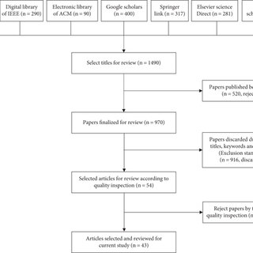

Slide 9
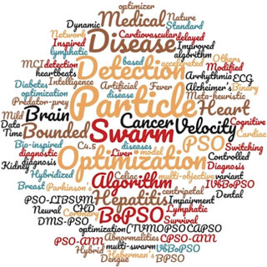

Slide 10
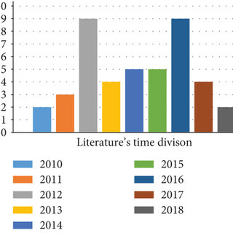

Slide 11
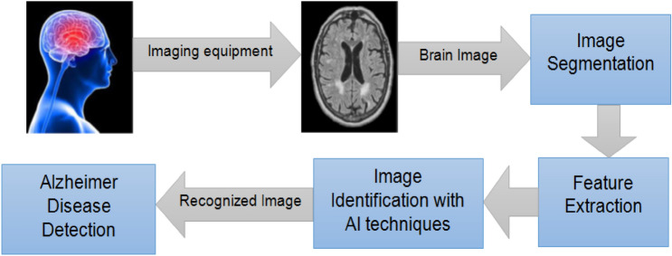

Slide 12
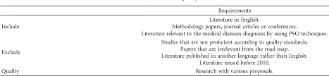

Slide 13
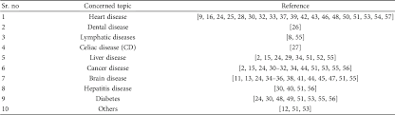

Slide 14
Conclusion

Slide 15
Thank You ALL

